Slide 1
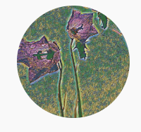
PCA – Why PCA

Slide 2
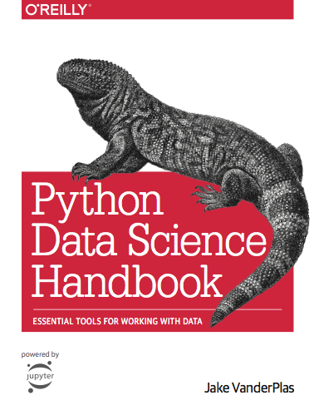
Reference
sklearn
Chapter 5.7 (O'Reilly)
Youtube
Code

Slide 3
Data

Slide 4



Slide 6
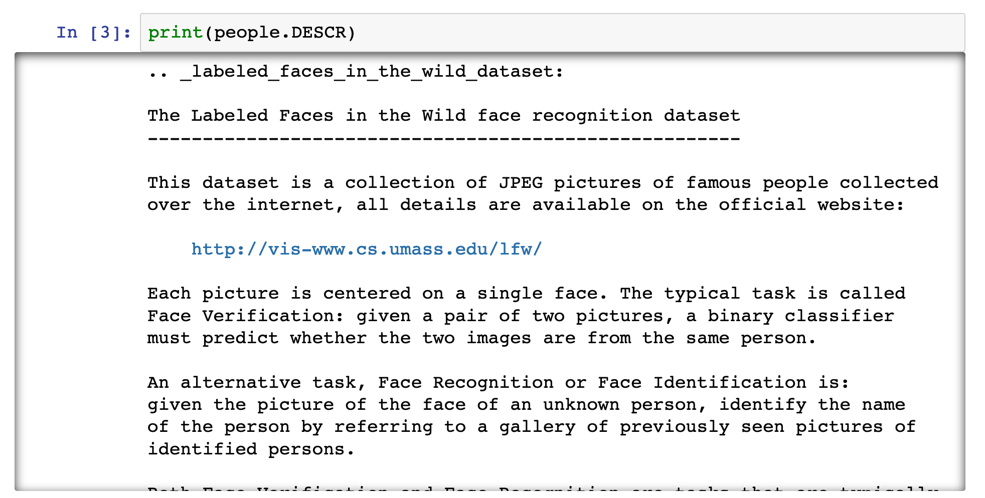

Slide 7
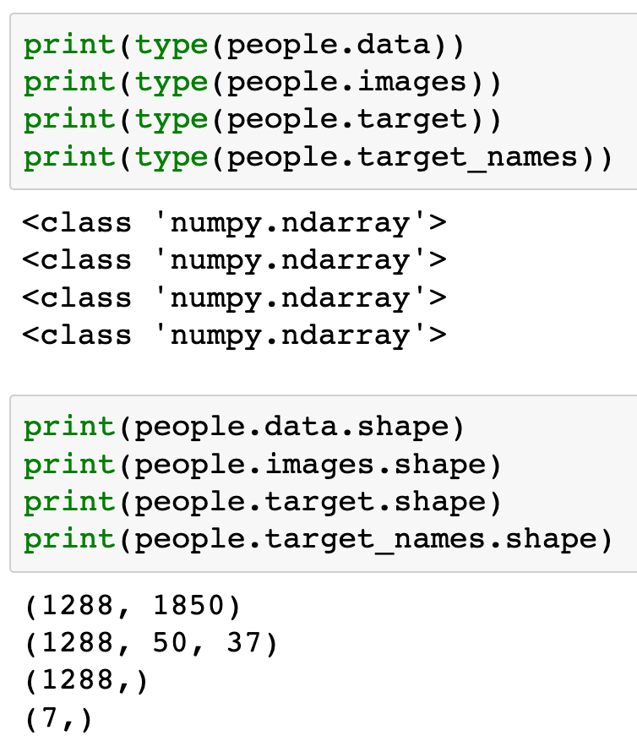

Slide 9


Slide 11
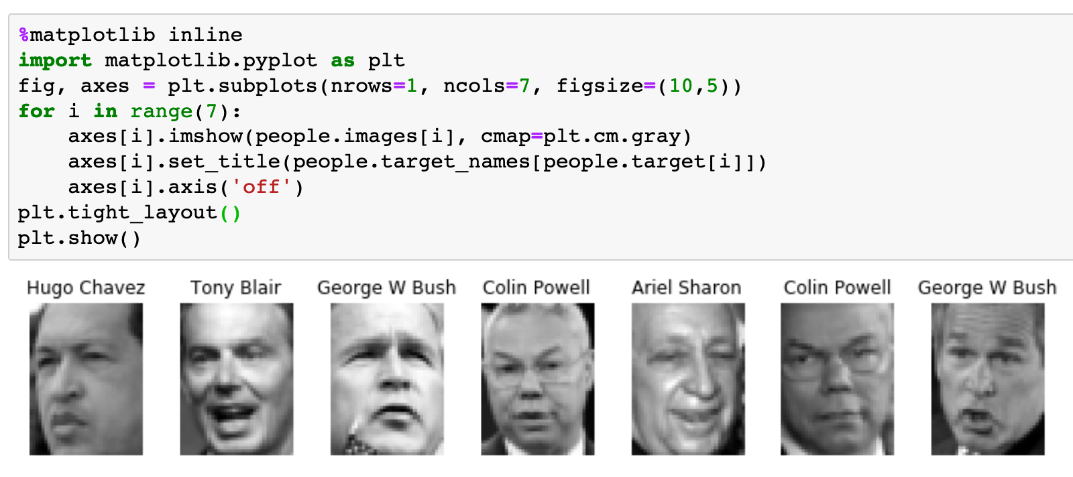

Slide 12
Train and Test Dataset

Slide 13
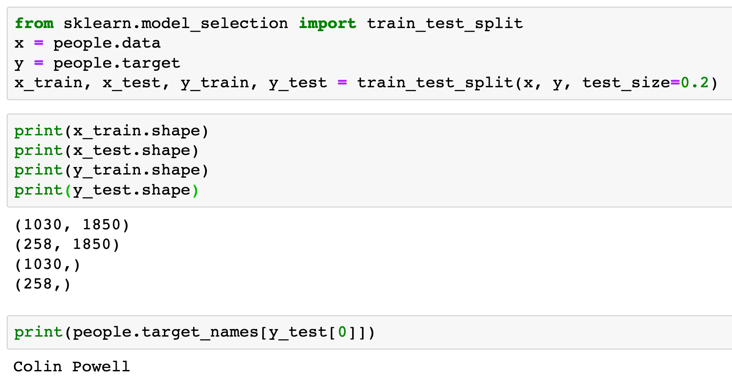

Slide 16
SVM

Slide 17
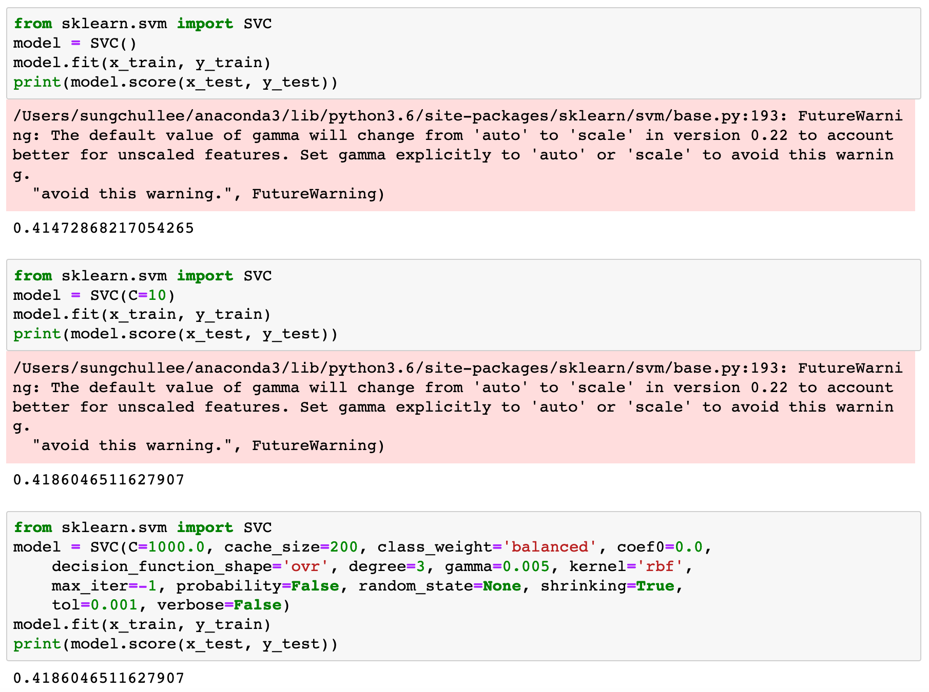

Slide 20
PCA

Slide 21


Slide 22
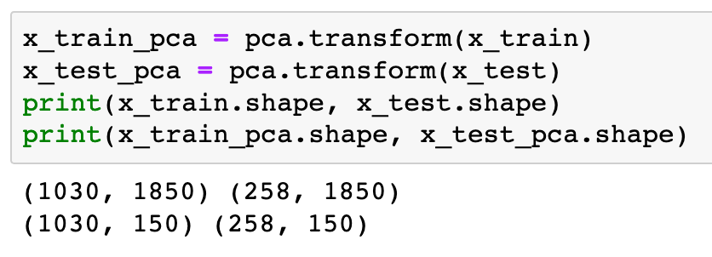

Slide 23
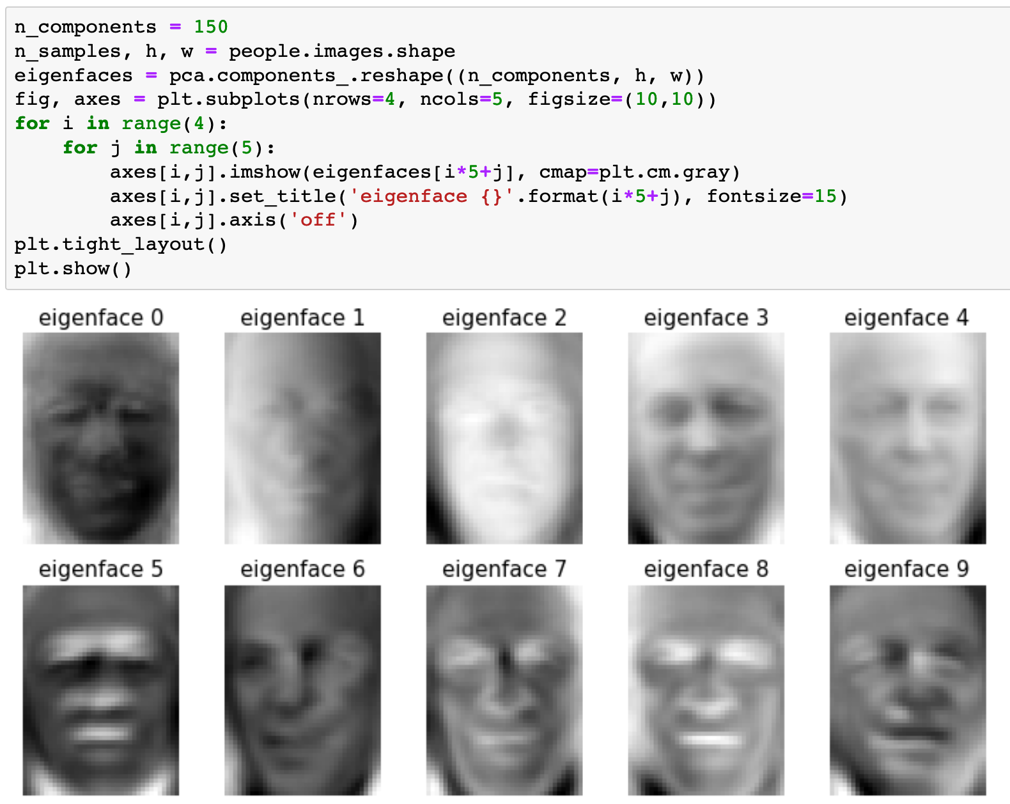

Slide 24
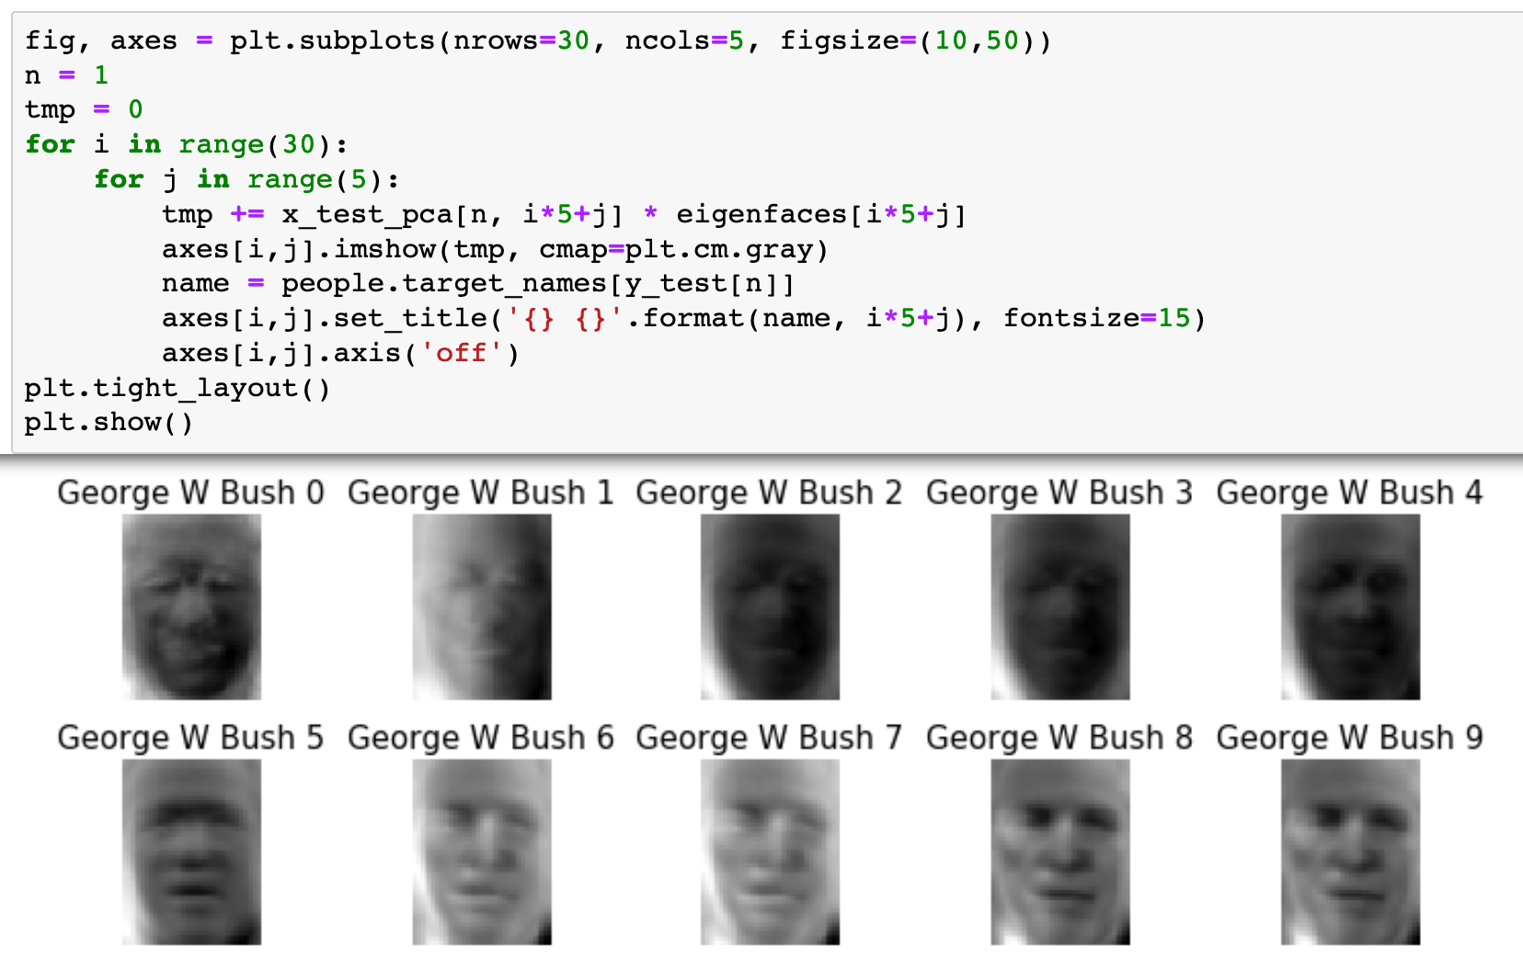

Slide 25
SVM with PCA

Slide 26


Slide 27
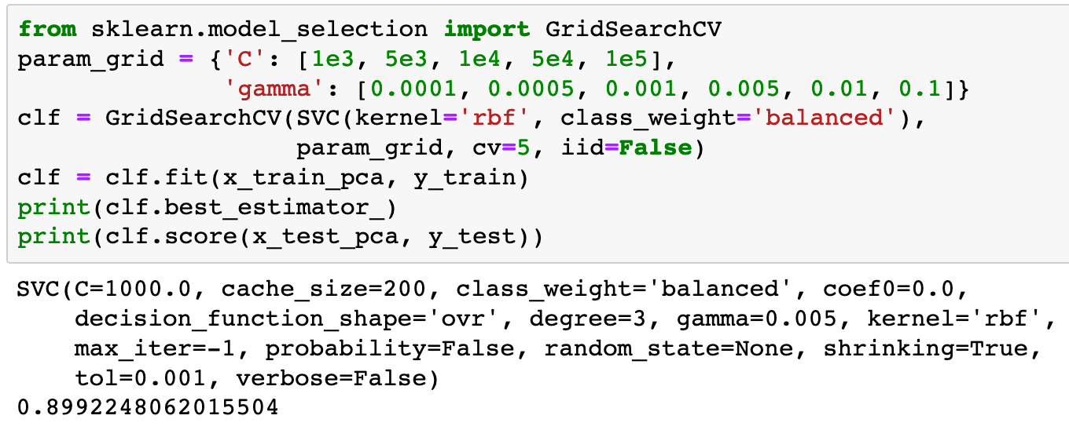

Slide 28
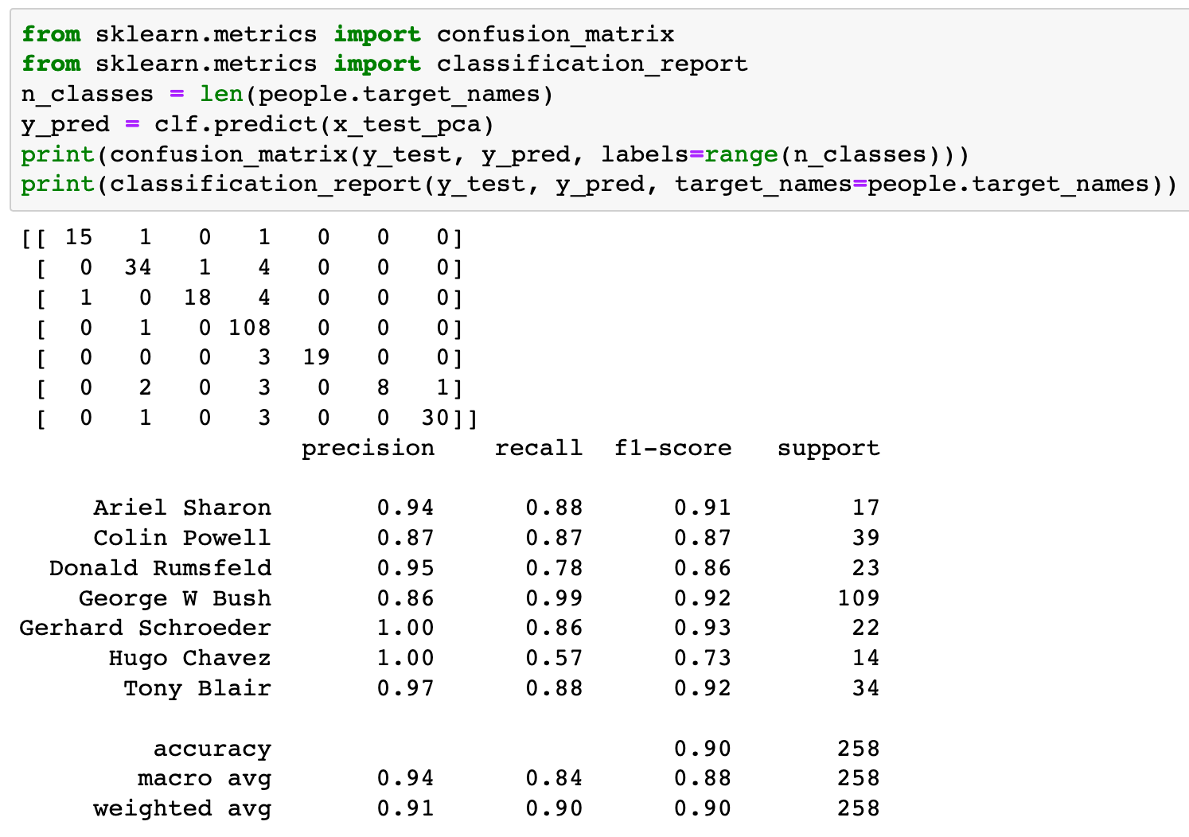

Slide 29
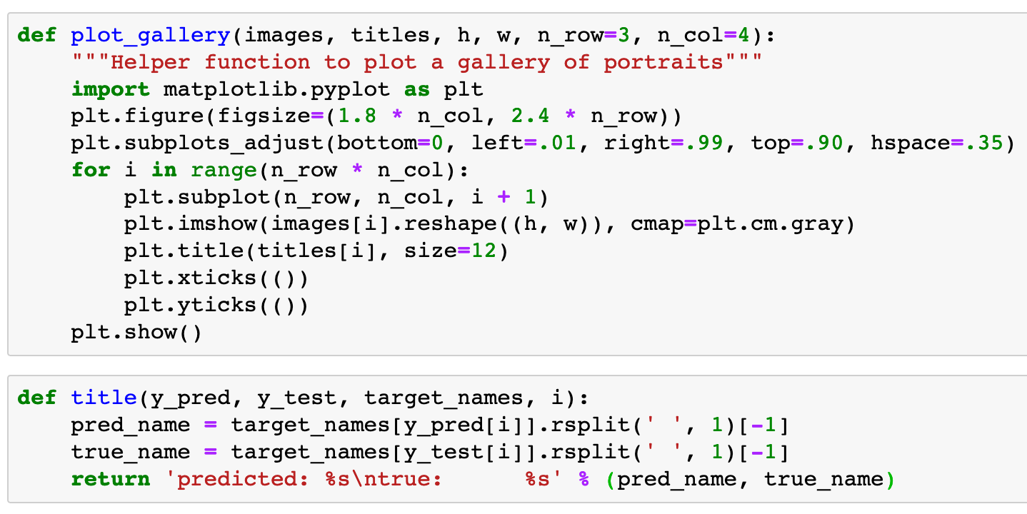


Slide 31
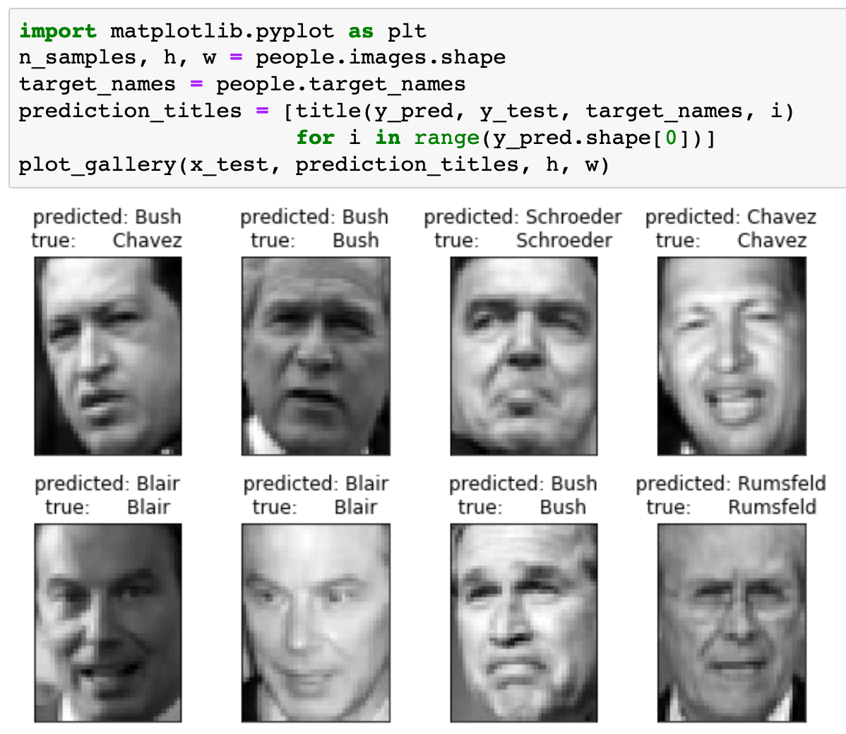

Slide 32
Now
Let’s Play with Code

